Slide 1


IMPROVING CUSTOMER RETENTION MANAGEMENT THROUGH COST-SENSITIVE LEARNING
BUSINESS ANALYTICS IN A SUSTAINABLE WORLD
September 2022
IÉSEG - School of Management, Campus de Lille et Paris

Slide 2






OUR TEAM
Nandini GANTAYAT
Student
Zhang ZHIBO
Student
Doménica QUIÑONES
Student
Kristof Coussement
Professor, Academic director

Slide 3
AGENDA
Executive Summary
Purpose
Customer retention and churn prediction
Methodology
Misclassification cost as a performance measure
Classification technique
Drawbacks of sampling-based cost-sensitive techniques
Non-sampling based cost-sensitive learning techniques
Findings and Conclusions
Insights

Slide 4
EXECUTIVE SUMMARY
Overview - relevance of incorporating different misclassification costs in churn prediction and managerial and financial implications
Methodology/approach – Cost-sensitive methodologies are tested in churn datasets from the retail industry
Findings– Normally used models(P50) are not viable when misclassification cost asymmetries are considered. DMECC is the most robust, cost-sensitive approach
Suggestions – expansion of this research area into new domains, applying new approaches and considerations will lead to efficient models

Slide 5

IMPORTANCE OF CONSIDERING THIS APPROACH
NICHE
Medical
Financial

Slide 6
PURPOSE
A subfield of ML that takes the costs of prediction errors into account when training a model.
Customers at risk
Fp redundant pampering cost
Fn forgoes profit
Optimize the accuracy minimize the total misclassification cost which can change the prediction results
Improving customer retention management
Misclassifying the customer as a non-churner results in
higher cost than predicting a customer will churn
GENERAL MODEL worst performance >0.5 - churner
Fp – false positive
Fn- false negative

Slide 7


CUSTOMER RETENTION AND CHURN PREDICTION
Retailers acknowledge that customer retention management becomes increasingly
important when markets become saturated and highly competitive
Defection
Rate

Slide 8
CUSTOMER RETENTION DRIVERS
01
03
05
07
Inter-customer Dynamics through social influence
Customer Usage Patterns
Customer Characteristics
Satisfaction
Multichannel Relational Communication
Loyalty Programs
Brand Equity
02
04
06

Slide 9
MISCLASSIFICATION COST AS A PERFORMANCE MEASURE
Performance of churn prediction models
Confusion/cost matrix
Actual behavioral outcome
Error rate
AUC
Top-decile lift
Churner
Non-churner
True Positives
False Positives
Churner
Predicted behavioral outcome
False Negatives
True Negatives
Non- churner
They do not lead to an optimal evaluation of the classification algorithm when different misclassification costs occur
$$Total misclassification cost= _{c11}TP+ _{c10}FP+ _{c00}TN+ _{c01}FN$$

Slide 10
METHODOLOGICAL PERSPECTIVE
Historical profile Information
Target Classes
Classification Model:
logistic regression
Assessing the probability of customer churn
Churners
Non-churners

Slide 11
DRAWBACKS OF SAMPLING BASED COST-SENSITIVE TECHNIQUES
DRAWBACKS
Distorted distribution
Reduced training data
Increased learning time of classifiers
Increases the proportion of churners
Duplicates the variables
OVERFITTING
UNDERFITTING

Slide 12
Relabeling
Threshold adjusting
Weighting
Wrappers
Non sampling based cost-sensitive techniques

Slide 13
CUSTOMER RETENTIONS
Various management and financial implications of customer retention
01
02
03
04
Better serve their current customer base rather than trying to find new customers
Old customers less prone to competitive marketing actions
Losing customers can lead to opportunity costs and increased costs
Long-term customers spend pattern is higher
14/09/2022
Improving customer retention management through cost-sensitive learning
13

Slide 14





FINDINGS & CONCLUSIONS
Ranking of the approaches based on wins/losses
Overview of the single best approach
Weightning
Cost ratios high and churn levels medium
Metacost
Cost ratios low and the churn level medium to high
DMECC
Most robust, cost-sensitive approach
Thresholding
Cost ratios low and churn level low to medium
P50
Not viable strategy when misclassification cost asymmetries are considered

Slide 15
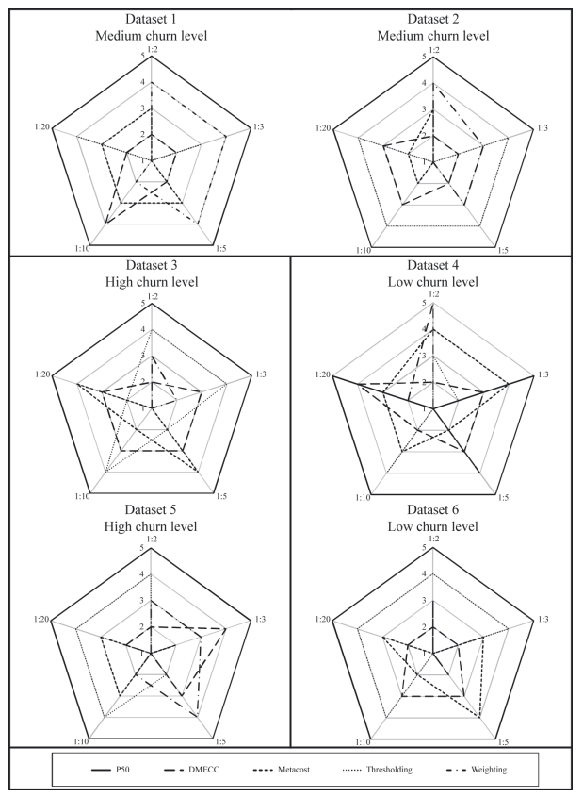
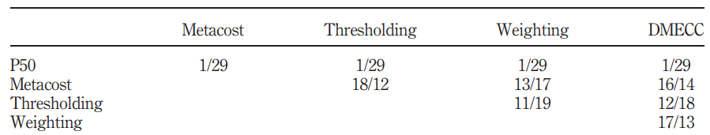
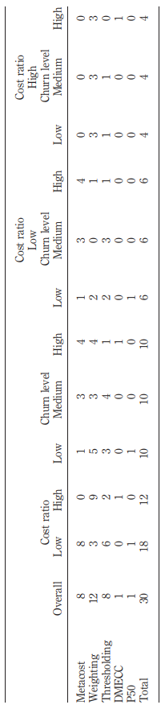
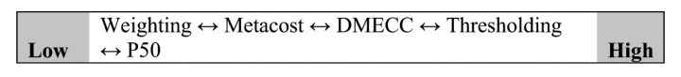
FINDINGS & CONCLUSIONS
Absolute ranking of the cost-sensitive learners per dataset
(with rank 1 = lowest to rank 5 = highest misclassification cost)
Summary of the empirical findings in terms of wins/losses
Ranking of the approaches based on wins/losses
Overview of the single best approach

Slide 16
INSIGHTS
New approaches
Cost-Sensitive Learning
AdaBoostWithCost classifier - reduce false-negative error and the misclassification cost more significantly than the other algorithms.
Different applications
System Security Problem
This approach is also critical in automatic intrusion detection systems.
Broader reach
Outliers might effect efficiency
Imbalanced datasets can be treated with this approach
Considerations

Slide 17
QUESTIONS?

Slide 18


Slide 19
BIBLIOGRAPHY
Thakkar et al. (2021). Clairvoyant: AdaBoost with Cost-Enabled Cost-Sensitive Classifier for Customer Churn Prediction. Computational Intelligence and Neuroscience Volume 2022, Article ID 9028580 Retrieved from: https://www.researchgate.net/publication/358071516_Clairvoyant_AdaBoost_with_Cost-Enabled_Cost-Sensitive_Classifier_for_Customer_Churn_Prediction
Choubineh et al. (2022) Applying separately cost-sensitive learning and Fisher's discriminant analysis to address the class imbalance problem: A case study involving a virtual gas pipeline SCADA system Retrevied from: https://www.sciencedirect.com/science/article/abs/pii/S1874548220300214
https://machinelearningmastery.com/cost-sensitive-learning-for-imbalanced-classification/
https://www.researchgate.net/publication/239551988_An_empirical_study_of_the_effect_of_outliers_on_the_misclassification_error_rate
https://ieeexplore.ieee.org/document/5596486
Encyclopedia of machine learning

Slide 20
NOUS CONTACTER
NOM DU SERVICE
IÉSEG School of Management
Campus Lille:
3 rue de la digue
59000 Lille
Mariadomenica.quinones@ieseg.fr
Nandini.gantayat1@ieseg.fr
Zhang7.zhibo@ieseg.fr
Service – 2015 – email_du_service@ieseg.fr
Crédits : ceti@ieseg.fr

